Slide 1

Multi Armed Bandits
By Keshav Bhandari

Slide 2
Table of Contents
Overview of Multi Armed Bandit Problem
Frequentist Approach – Upper Confidence Bound
Bayesian Approach – Thompson Sampling
Bayesian Inference
Bernoulli Distribution
Binomial Distribution
Beta Distribution
Conjugate Priors
Beta Distribution Conjugate Prior To Bernoulli & Binomial Likelihood Function

Slide 3
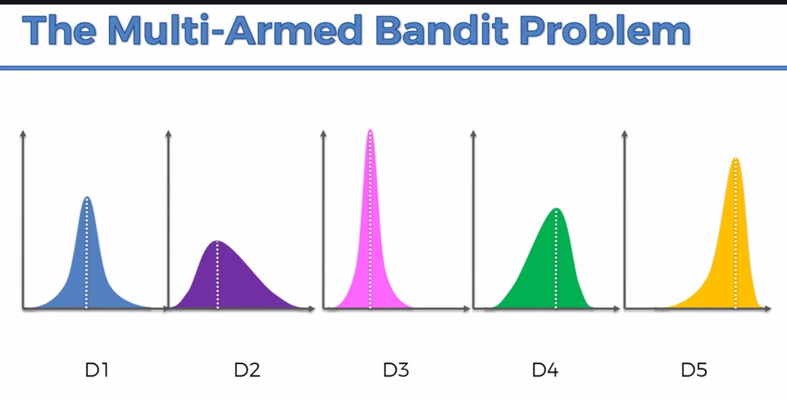
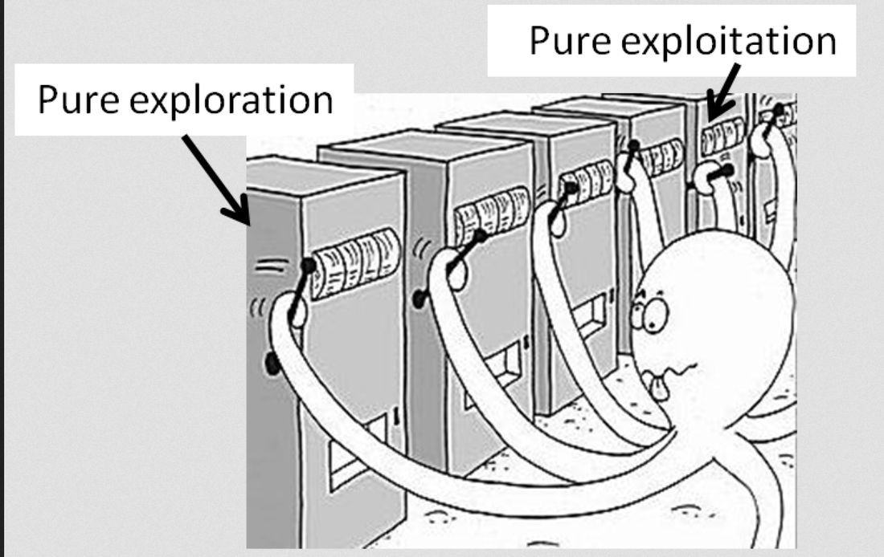
Overview of Multi Armed Bandit Problem
What is it?
The exploration vs. exploitation tradeoff
Some applications:
AB Testing
Ad Optimization
Recommendation Systems
Artificial Intelligence
Reinforcement Learning
Machine Learning
Evolutionary Programming

Slide 4

Overview of Multi Armed Bandit Problem
We have d arms. For example, arms are ads that we display to users each time they connect to a web page
Each time a user connects to a page, that makes a round
At each round n, we choose one ad to display to the user
At each round n, ad i gives reward $r_{i}$(n) $∈$ {0,1}: $r_{i}$(n) = 1 if the user clicked on the ad i, 0 if the user didn’t
Our goal is to maximize the total goal reward we get over many rounds

Slide 5
Upper Confidence Bound Algorithm
True Return
Observed Return
Return
D1
D2
D3
D4
D5
Output: 0

Slide 6
Upper Confidence Bound Algorithm
True Return
Observed Return
Return
D1
D2
D3
D4
D5
Output: 0
Output: 1

Slide 7
Upper Confidence Bound Algorithm
True Return
Observed Return
Return
D1
D2
D3
D4
D5
Output: 1

Slide 8
Upper Confidence Bound Algorithm
True Return
Observed Return
Return
D1
D2
D3
D4
D5
In the long run, the expected values and true values of the average converge and the ad which has been exploited the most will have a narrower confidence range. In our example, D4 has been exploited the most.

Slide 9

Upper Confidence Bound Algorithm
At each round n, we consider two numbers for each ad i:
$N_{i}$(n) – The number of times the ad i was selected up to round n
$R_{i}$(n) – The sum of rewards of the ad i up to round n
From these two numbers, we compute:
The average reward of ad i up to round n
$\overline{r_{i}}$(n) = $\frac{R_{i}\text{(}\text{n}\text{)}}{N_{i}\text{(}\text{n}\text{)}}$
The confidence interval [$\overline{r_{i}}$(n) - $∆_{i}$ (n) , $\overline{r_{i}}$(n) + $∆_{i}$ (n)] at round n with
$∆_{i}$ (n) = $\sqrt{\frac{3}{2}\frac{log⁡(n)}{N_{i}\text{(}\text{n}\text{)}}}$
We select the ad i that has the maximum UCB $\overline{r_{i}}$(n) + $∆_{i}$ (n)

Slide 10
Thompson Sampling Algorithm
True Return
D1
D2
D3
Observed Return
Goal is not to estimate the true distribution but rather where the true return might lie
Return

Slide 11
Thompson Sampling Algorithm
True Return
D1
D2
D3
Observed Return
Goal is not to estimate the true distribution but rather where the true return might lie
Return

Slide 12
Thompson Sampling Algorithm
True Return
D1
D2
D3
Observed Return
Goal is not to estimate the true distribution but rather where the true return might lie
Return
In the long run, as more and more data is available the expected return and true return of the average converge and the ad that is exploited the most has a narrower distribution (higher kurtosis). In our example, D3 has been exploited the most.

Slide 13

Thompson Sampling Algorithm
Ad $i$ gets rewards $y$ from a Bernoulli distribution $p(y|θ_{i}\text{) \sim }\text{B}\text{(}θ_{i})$.
${\text{ϴ} }_{i}$ is unknown but we set its uncertainty by assuming it has a uniform distribution $p\left({\text{ϴ} }_{i}\right) \sim u([0,1])$, which is the prior distribution.
Bayes rule: We approach ${\text{ϴ} }_{i}$ by the posterior distribution
$p(θ_{i}|y\text{)}\text{ = }\frac{p(y|θ_{i})\text{ . }p(θ_{i})}{\int_{0}^{1}{p\left(y | θ_{i}\right)\text{ . }p\left(θ_{i}\right) dθ_{i}}}$ ∝ $p(y|θ_{i})$ × $p(θ_{i})$
Posterior Distribution
Likelihood Function
Prior Distribution

Slide 14

Thompson Sampling Algorithm
We get $p(θ_{i}|y\text{)}$ ~ Beta (number of successes + 1, number of failures + 1)
At each round $n$, we take a random draw $θ_{i}$($n$) from this posterior distribution $p(θ_{i}|y\text{)}$ for each ad $i$
At each round $n$ we select the ad $i$ that has the highest $θ_{i}$($n$)

Slide 15



Bayesian Inference: Bernoulli Distribution
Heads (X=1)
P(X = 1) = ϴ
P(X = K) = ${ϴ }^{K}{(1−ϴ )}^{1−K}$, where K = 1 or 0
Tails (X=0)
P(X = 0) = 1-ϴ
Verification:
P(X = 0) = ${ϴ }^{0}{(1−ϴ )}^{1}$ => 1-ϴ
P(X = 1) = ${ϴ }^{1}{(1−ϴ )}^{0}$ => ϴ
Bernoulli Distribution: Binary Event
Q. What if we want to flip the coin 3 times and work out the probability of (H,H,T)?
Multiply single event probabilities
P($X_{1}$=1, $X_{2}$=1, $X_{3}$=0) = ϴ* ϴ*(1- ϴ) => ${\text{ϴ}}^{2}$(1- ϴ)

Slide 16
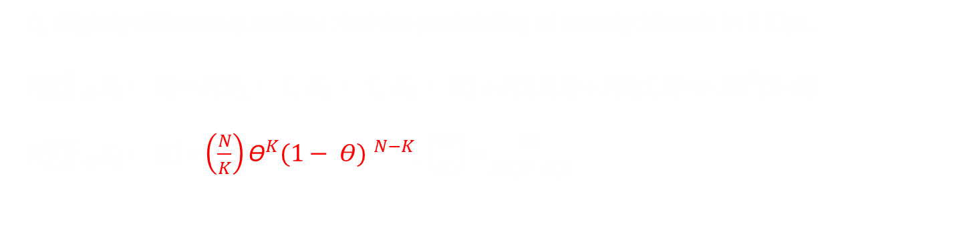
Bayesian Inference: Binomial Distribution
Q. Slightly different question: Find the probability of exactly 2 heads in 3 flips.
P($\sum_{i=1}^{3}{X_{i}=2}$) = P($X_{1}=1$, $X_{2}=1$, $X_{3}=0)$ + P(1,0,1) + P(0,1,1) => ${\text{3}\text{ϴ}}^{2}$(1- ϴ)
P($\sum_{i=1}^{K}{X_{i}=K}$) = $\left(\frac{N}{K}\right){\text{ϴ}}^{K}{(1− Θ) }^{N−K}$, $\left(\frac{N}{K}\right)$ = $\frac{N!}{K!\left(N−K\right)!}$
Binomial Distribution: Multiple Events

Slide 17
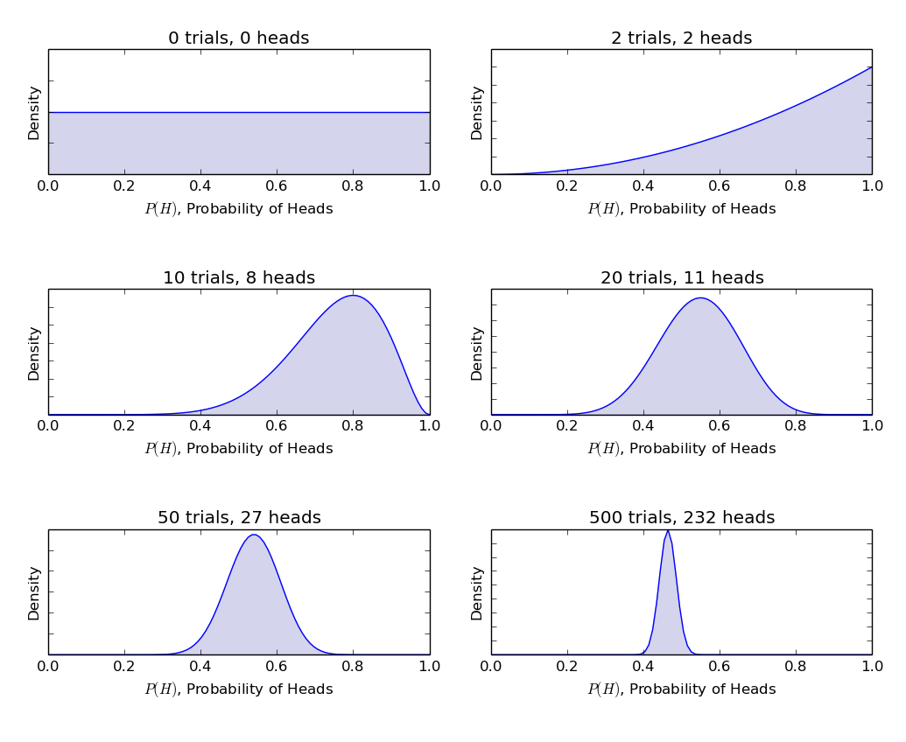

Bayesian Inference: Beta Distribution
Probability density function of beta distribution is of the form:
$$\frac{x^{α−1}.{(1−x)}^{β−1}}{B(α,β)}$$
The denominator is there just to ensure that the total probability density function upon integration evaluates to 1.
α and β are called the shape deciding parameters of the density function. Here α is analogous to number of heads in the trials and β corresponds to the number of tails. The diagrams on the left help visualize the beta distributions for different values of α and β

Slide 18
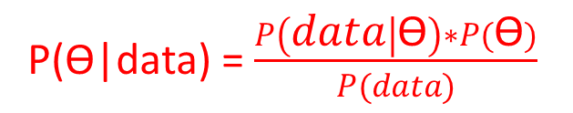
Bayesian Inference: Conjugate Priors
1
2
4
P(ϴ|data) = $\frac{P\left(data | \text{ϴ}\right)∗P(\text{ϴ})}{P(data)}$
3
P(D|θ) is the likelihood of observing our result given our choice for θ. If we knew that coin was fair, this gives the probability of observing the number of heads in a particular number of flips.
P(θ) is the prior i.e. the strength of our belief in the fairness of coin before the toss. It is perfectly okay to believe that coin can have any degree of fairness between 0 and 1.
P(D) is the evidence. This is the probability of data as determined by summing (or integrating) across all possible values of θ, weighted by how strongly we believe in those particular values of θ.
P(θ|D) is the posterior belief of our parameters after observing the evidence i.e. the number of heads.
To define our model correctly , we need two mathematical models before hand. One to represent the likelihood function P(D|θ) and the other for representing the distribution of prior beliefs . The product of these two gives the posterior belief P(θ|D) distribution

Slide 19

Bayesian Inference: Conjugate Priors
The normal distribution is conjugate to the normal likelihood
P(ϴ|data) = $\frac{P\left(data | \text{ϴ}\right)∗P(\text{ϴ})}{P(data)}$
If 𝑃(𝑑𝑎𝑡𝑎│ϴ ) ~ Normal and we choose 𝑃(ϴ) ~ Normal, then P(ϴ|data) ~ Normal
Note: The posterior distribution being Normal and of the same form as the prior isn’t necessarily the case if we were to choose a different prior distribution. Example, if we chose the prior as a Gamma distribution, we might end up with quite a different posterior distribution (probably a very bad one).
When the posterior distribution is of the same form as that of the prior, the prior is said to be a conjugate prior of the likelihood function.
If Likelihood ~ ${ϴ }^{K}{(1−ϴ )}^{N−K}$ (Bernoulli) and Prior ~ ${ϴ }^{a−1}{(1−ϴ )}^{b−1}$ (Beta), then Posterior ~ Beta
In this case, the beta distribution is conjugate to a Bernoulli trial. This means the posterior is Beta distributed.

Slide 20
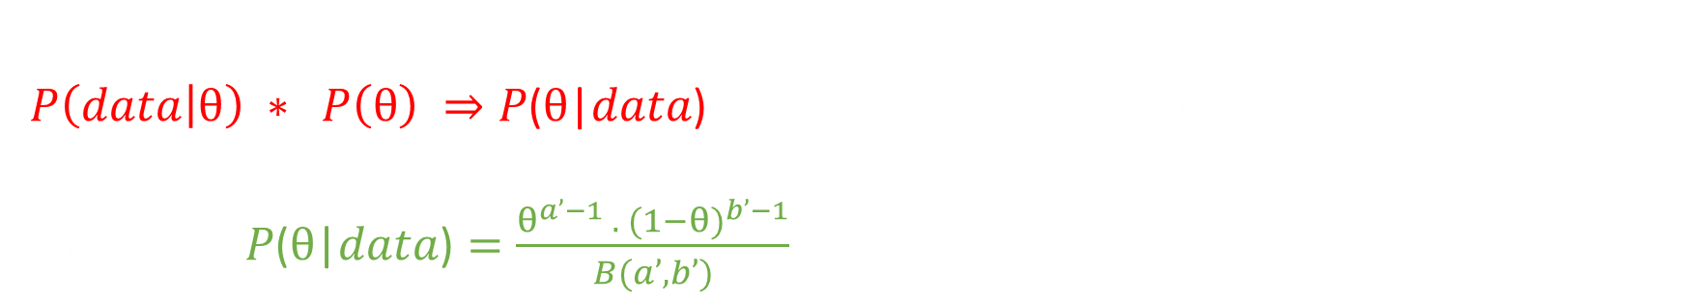
Bayesian Inference: Beta Distribution Conjugate to Bernoulli & Binomial Likelihood
Bayes Theorem: $P\text{(}θ\text{|}data\text{)}$ = $\frac{P\left(data | θ\right)∗P(θ)}{P(data)}$ ∝ $P\left(data | θ\right) ∗ P(θ)$
Beta ($a, b$) = $\frac{θ^{α−1} . {(1−θ)}^{β−1}}{B(α,β)}$ => $Constant ∗ θ^{α−1} ∗ {(1−θ)}^{β−1}$ (1)
Prior: $P\left(θ\right) \text{∝} θ^{α−1} ∗ {(1−θ)}^{β−1}$
Bernoulli/Binomial Likelihood: $P\left(data | θ\right)$ ∝ ${ϴ }^{z}{(1−ϴ )}^{N−z}$ ; z = $\sum_{i=0}^{N}{x_{i}}$ (2)
Substituting (1) and (2) into the Bayes Theorem,
$P\left(data | θ\right) ∗ P\left(θ\right) ⇒P\text{(}θ\text{|}data\text{)}$ ∝ $θ^{α+z−1} ∗ {(1−θ)}^{N+β−z−1}$
Replace $a’ =α+ z$ and $b’ = N +β− z$
Therefore, $P\text{(}θ\text{|}data\text{)}=\frac{θ^{a’−1} . {(1−θ)}^{b’−1}}{B(a’, b’)}$
Posterior Distribution is Beta Distributed

Slide 21

Appendix: Explanation of UCB Formula
UCB = $\overline{r_{i}}$(n) + $c\sqrt{\frac{log⁡(n)}{N_{i}\text{(}\text{n}\text{)}}}$
The upper confidence bound is the empirical mean plus this exploration term
c is a constant which lets the user set the exploration/exploitation trade-off. For theoretical results it is often optimized for the problem at hand
$\sqrt{\frac{1}{N_{i}\text{(}\text{n}\text{)}}}$ is proportional to the posterior standard deviation after $N_{i}$ samples of action i. Essentially this says that as you pull an arm more often, there is less unknown about the arm.
$\sqrt{log⁡(n)}$ ensures that you don't stop exploring too early. As N becomes very large, the sample variances become small enough that we need to compensate to ensure that we never completely stop exploring. Most of the technical math is to show that $\sqrt{log⁡(n)}$ is just enough (but not too much) compensation.
For a technical explanation please check this paper by Auer et al.

Slide 22
Appendix

